Slide 1

HTML tags

Slide 2

HTML <div> Tag
The <div> tag defines a division or a section in an HTML document.
The <div> element is often used as a container for other HTML elements to style them with CSS or to perform certain tasks with JavaScript.
Div tag is Block level tag
It is a generic container tag
It is used to the group of various tags of HTML so that sections can be created and style can be applied to them.

Slide 3
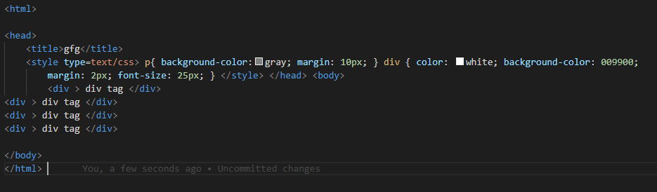
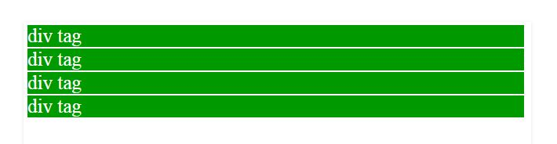
Output:

Slide 4
HTML Lists
HTML lists are used to present list of information in well formed and semantic way. There are three different types of list in HTML and each one has a specific purpose and meaning.
Unordered list — Used to create a list of related items, in no particular order.
Ordered list — Used to create a list of related items, in a specific order.
Description list — Used to create a list of terms and their descriptions.

Slide 5
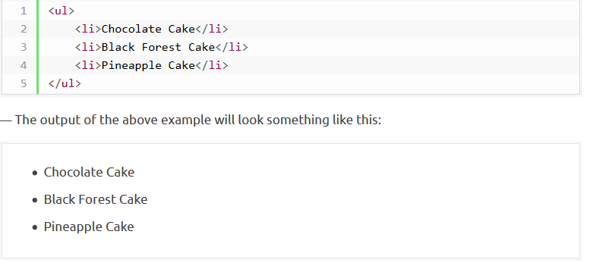
HTML Unordered Lists
An unordered list created using the <ul> element, and each list item starts with the <li> element. The list items in unordered lists are marked with bullets.

Slide 6

You can also change the bullet type in your unordered list using the CSS list-style-type property. The following style rule changes the type of bullet from the default disc to square

Slide 7
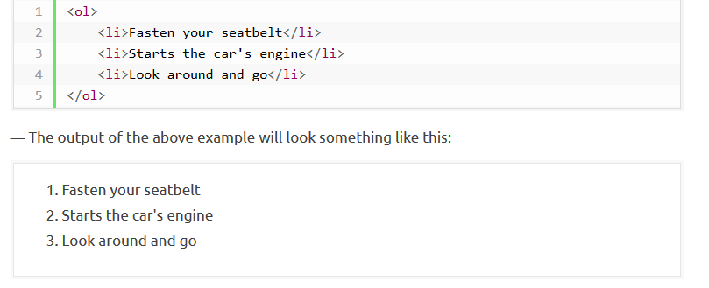
HTML Ordered Lists
An ordered list created using the <ol> element, and each list item starts with the <li> element. Ordered lists are used when the order of the list's items is important.The list items in an ordered list are marked with numbers.

Slide 8
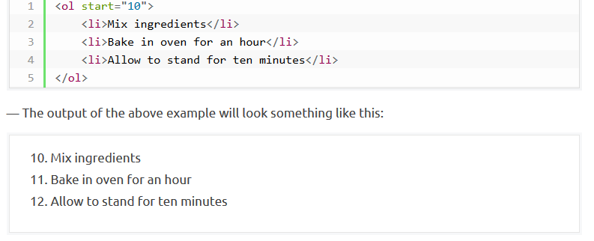
The numbering of items in an ordered list typically starts with 1. However, if you want to change that you can use the start attribute, as shown in the following example:

Slide 9
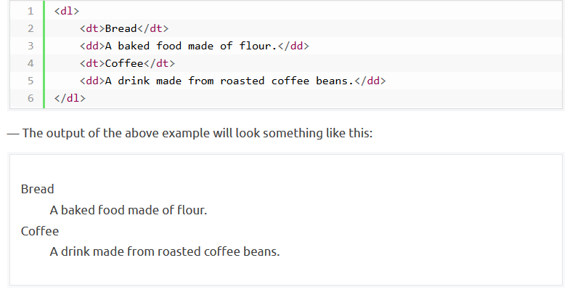
HTML Description Lists
A description list is a list of items with a description or definition of each item. The description list is created using <dl> element. The <dl> element is used in conjunction with the <dt> element which specify a term, and the <dd> element which specify the term's definition.

Slide 10
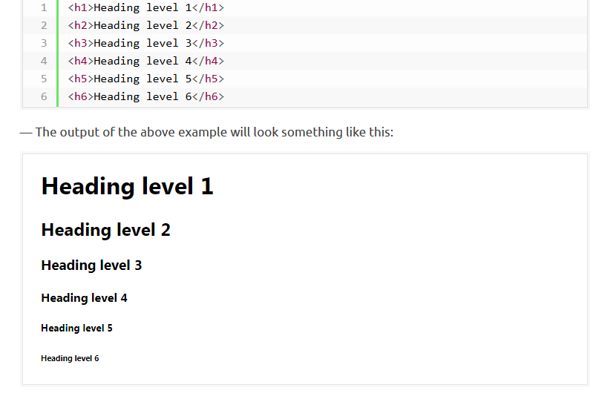
HTML Headings
Headings help in defining the hierarchy and the structure of the web page content.
HTML offers six levels of heading tags, <h1> through <h6>; the higher the heading level number, the greater its importance — therefore <h1> tag defines the most important heading, whereas the <h6> tag defines the least important heading in the document.
By default, browsers display headings in larger and bolder font than normal text. Also, <h1> headings are displayed in largest font, whereas <h6> headings are displayed in smallest font.

Slide 11
Importance of Headings
HTML headings provide valuable information by highlighting important topics and the structure of the document, so optimize them carefully to improve user engagement.
Don't use headings to make your text look BIG or bold. Use them only for highlighting the heading of your document and to show the document structure.
Since search engines, such as Google, use headings to index the structure and content of the web pages so use them very wisely in your webpage.
Use the <h1> headings as main headings of your web page, followed by the <h2> headings, then the less important <h3> headings, and so on.

Slide 12
HTML Paragraphs
Paragraphs are defined with the <p> tag. Paragraph tag is a very basic and typically the first tag you will need to publish your text on the web pages. Here's an example:

Slide 13
Managing White Spaces
Normally the browser will display the multiple spaces created inside the HTML code by pressing the space-bar key or tab key on the keyboard as a single space. Multiple line breaks created inside the HTML code through pressing the enter key is also displayed as a single space.
The following paragraphs will be displayed in a single line without any extra space

Slide 14
